Slide 1




ELECTRIC VEHICLE DESIGN
List of team members:
1.CHARAN M
2.NITHIN S.G
3.VASHEEL KUMAR S
4.VISHAL TM

Slide 2
TABLE OF CONTENTS
Targets
Performance and Parameters
Motor Considerations and Results
Invertor and Controller
Switches
Simulink model and Result

Slide 3
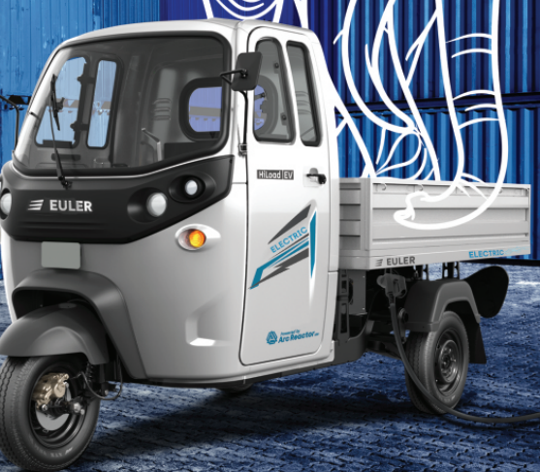
TARGETS
Design and Simulation of Electric Vehicle
Vehicle segment: 3-wheeler
Model: Euler Hiload PV
To increase the existing load capacity by 50% and
add a hub motor to compensate it.
Replacing 3 phase induction motor with brushless dc motor.
To incorporate two batteries types instead of one.

Slide 4
PERFORMANCE AND PARAMETERS
PERFORMANCE | TARGETS
ACCELERATION | 0.55 m/s2
TOP SPEED | 44 km/hr
GRADEABILITY | 21%/ 9.45 degrees
LOAD CAPACITY | 1032 kg
RANGE | 129 Km
BATTERY CAPACITY TOTAL |  | 40.5 kWh
BATTERY CAPACITY Li |  | 12.15 kWh
BATTERY CAPACITY AL Air |  | 28.35 kWh
AERODYNAMIC DRAG COEFFICIENT |  | 0.5546
FRONTAL AREA |  | 2.186
COEFFICIENT OF ROLLING RESISTANCE |  | 0.010

Slide 5
RESISTANCE
Motor Consideration - BLDC
Reason
Rotor inertia is lower
Higher efficiency
Smaller in size when compared to induction with same power
Main
Power – 14 kW
speed - 12.5m/s
max wheel rpm - 796.17 rpm
Hub
Power – 2 kW
speed -12.5m/s
hub speed - 12.5 m/s
max rpm - 785 rpm
Rolling resistance – 172N
Aerodynamic resistance – 111N
Gradient – 2833N
Peak Power Needed -16 kW
Peak Torque -88 N-m
Final Drive - 2.4382

Slide 6
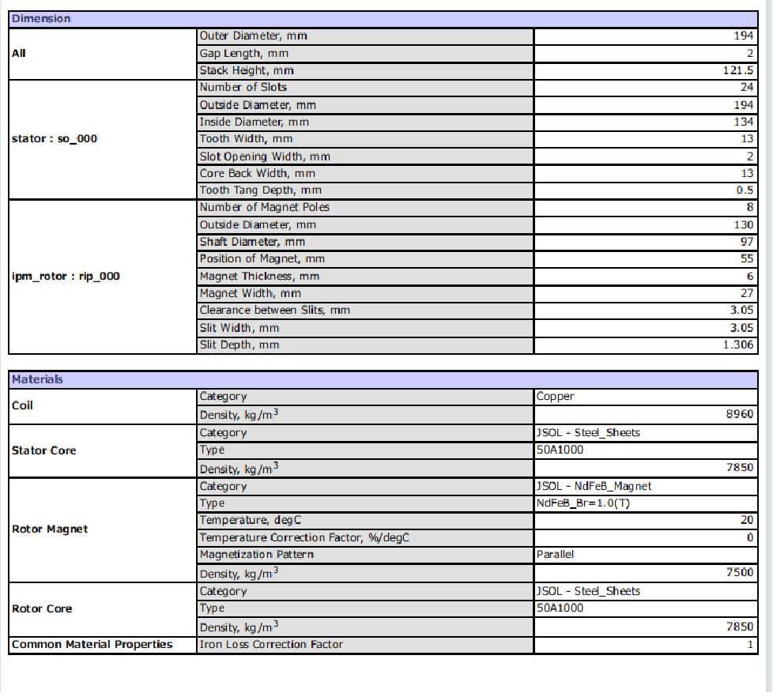
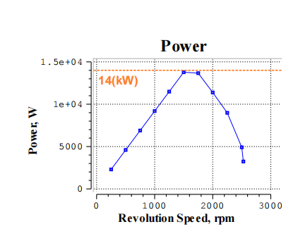
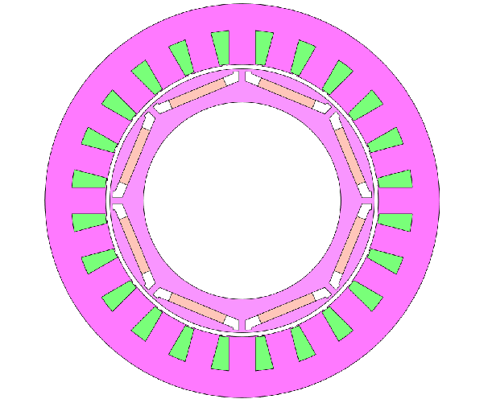
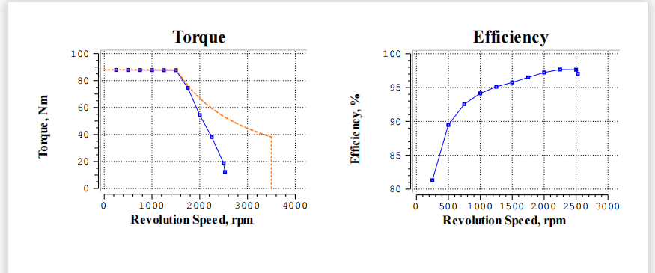
MAIN MOTOR

Slide 7
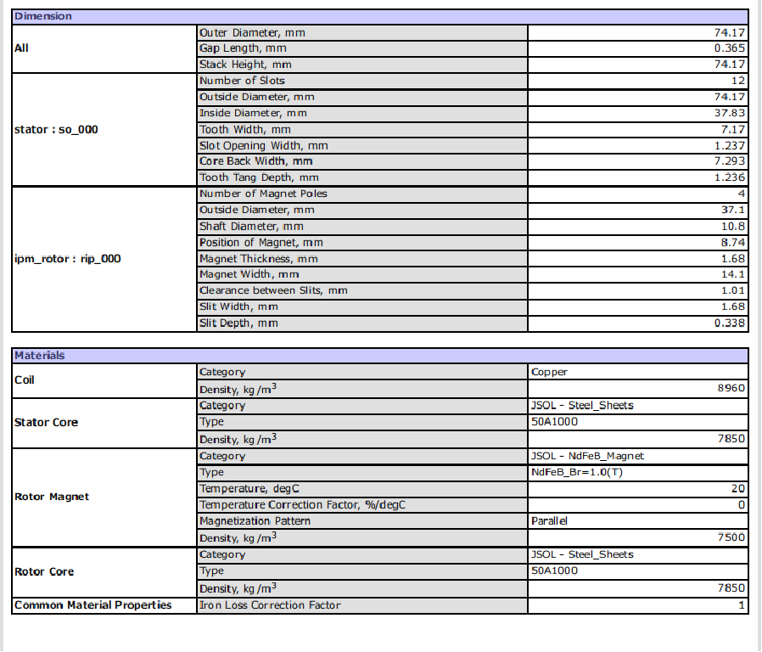
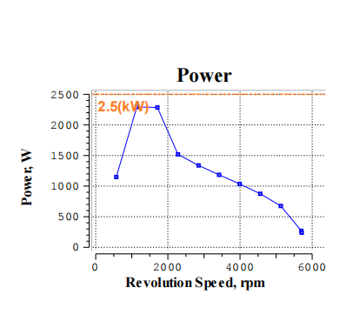
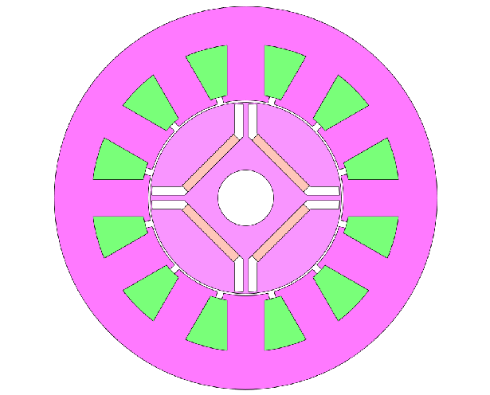
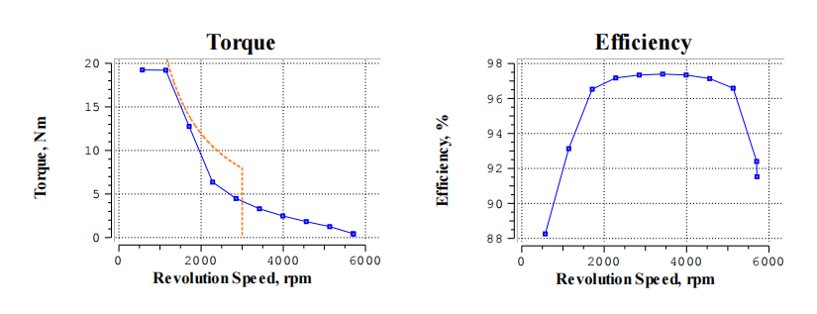
HUB MOTOR

Slide 8
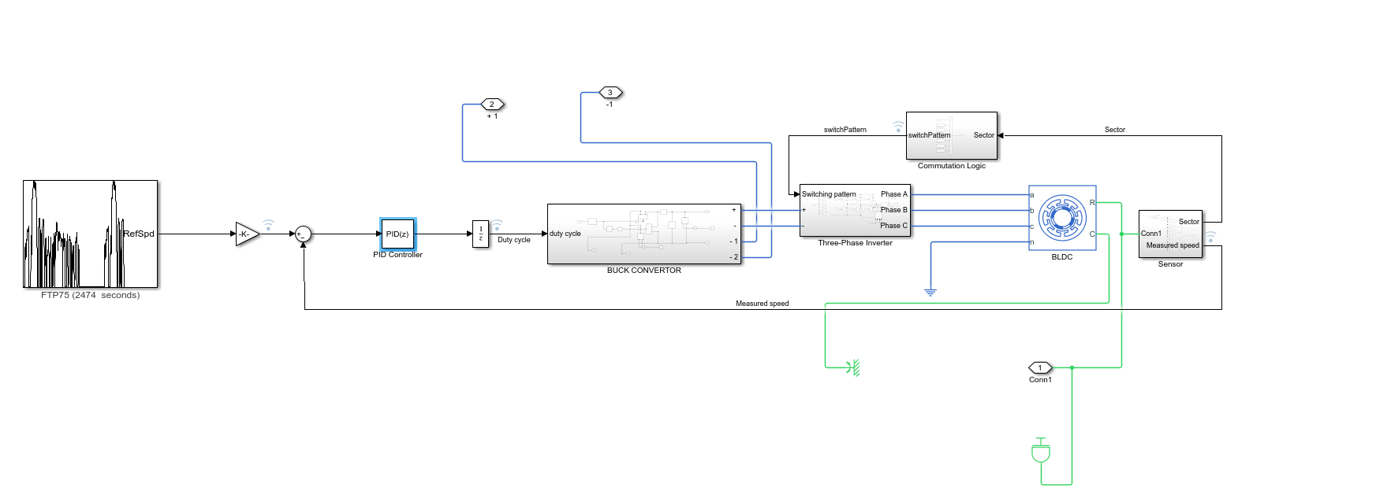
DESIGN CONSIDERATION
Controller - Trapezoidal control (Trap)
Reason:
Highest maximum speed
Great for delivering maximum torque
Lowest switching losses
Easier implementation
Considerations
Line voltage – Main Motor (200 V), Hub motor(200 V)
PID Controller – Main Motor (0.0045,0.5356,4.6679)
Hub Motor(0.0220,0.4817,7.2868)
Drive cycle – FTP75 (City Urban Drive Cycle)

Slide 9
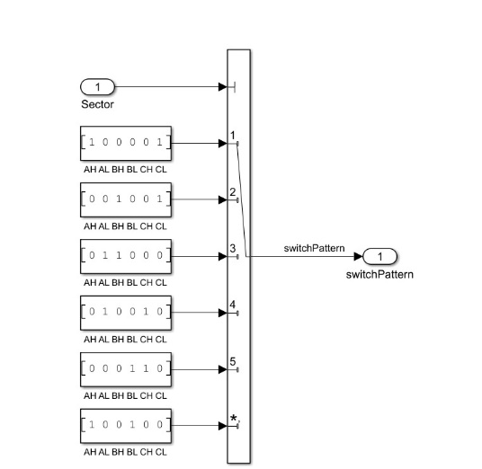
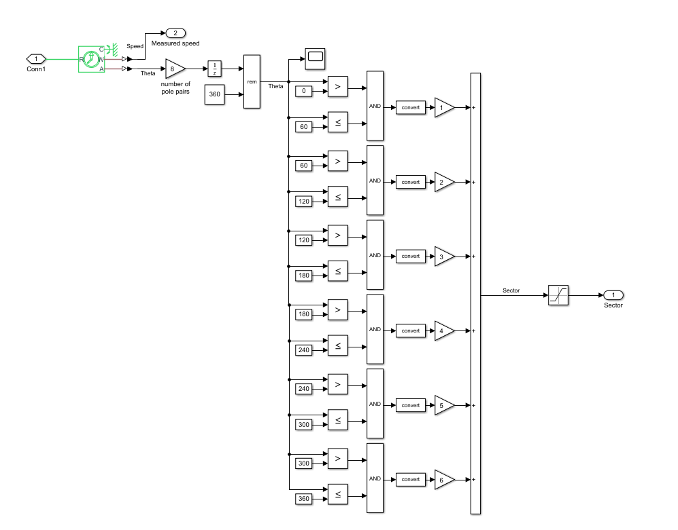
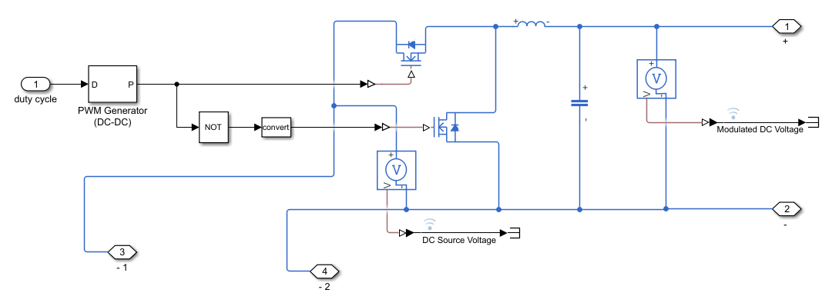
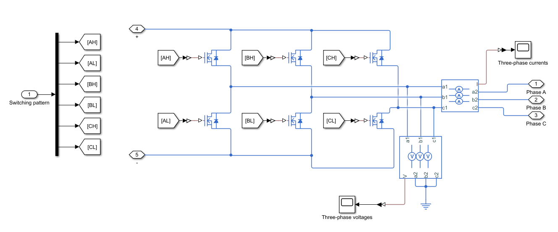
INVERTER AND CONTROLLER
Commutation Logic
Hall Sensor
Buck Convertor
Inverter

Slide 10
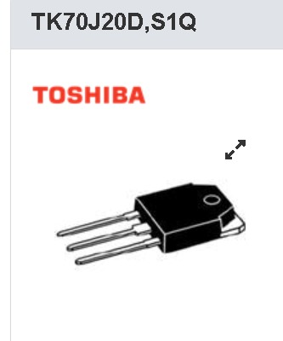
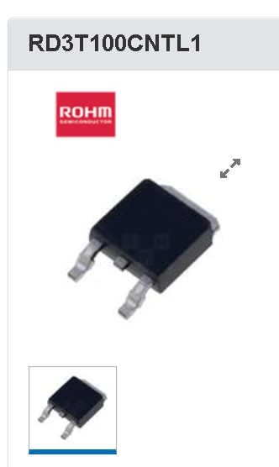
SWITCHES : N –Channel MOSFET
Main Motor:-
Ploss = 109.44 W
Pcond = 94.8 W
Poff = 8.68 W
Pon = 5.88 W
Hub Motor:-
Ploss = 14.29W
Pcond = 14.09 W
Poff = 0.012W
Pon = 0.0750 W
D=0.6 ; % duty cycle
FSW= 8000 ; %switching frequency
Vin = 200 V;
I= 70 A ;
Rds= 0.027 ohm ;
ton = 105 ns ;
toff= 155 ns;
D=0.6 ; % duty cycle
FSW= 3000 ; %switching frequency
Vin = 200 V;
I= 10 A;
Rds= 0.182 ohm;
ton =25 ns ;
toff=40 ns;

Slide 11
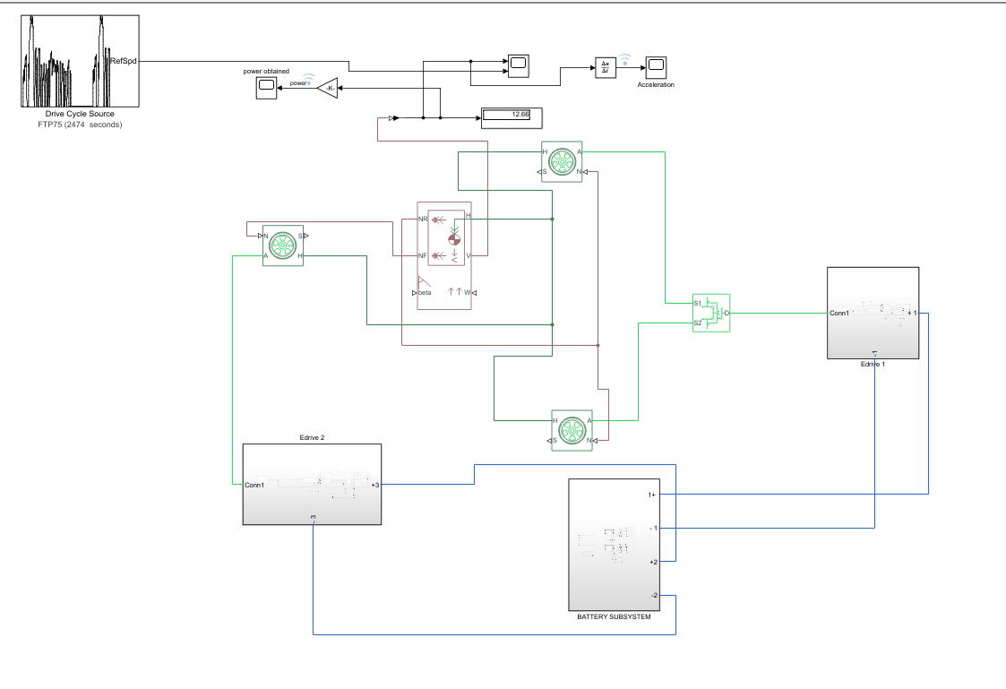
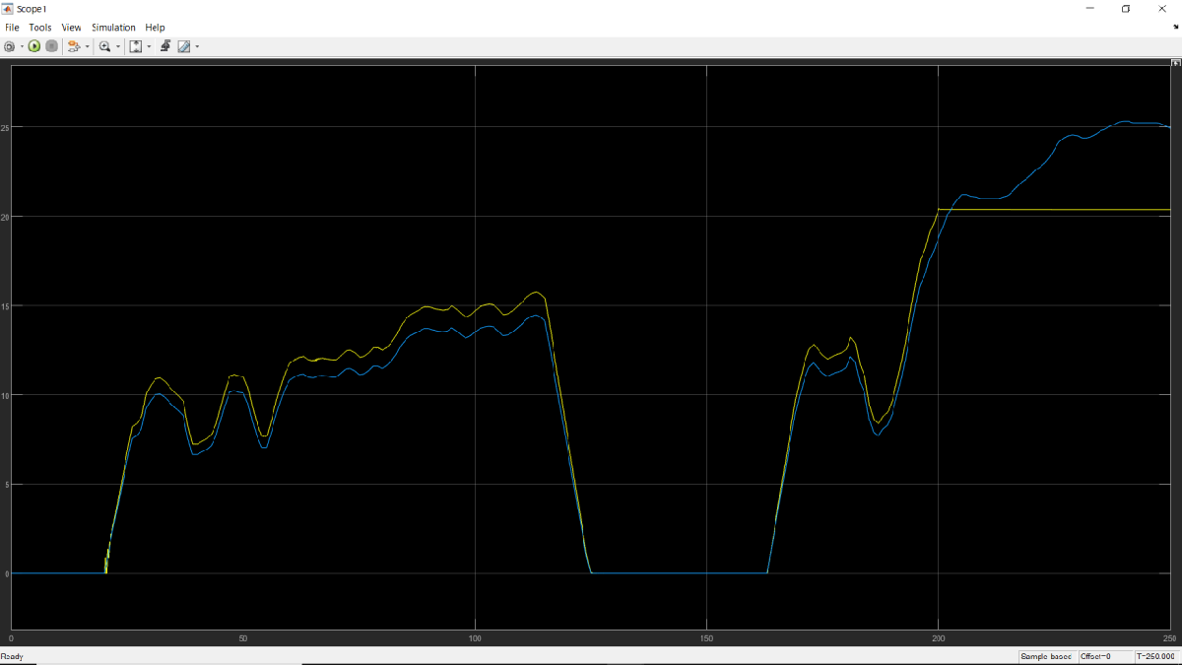
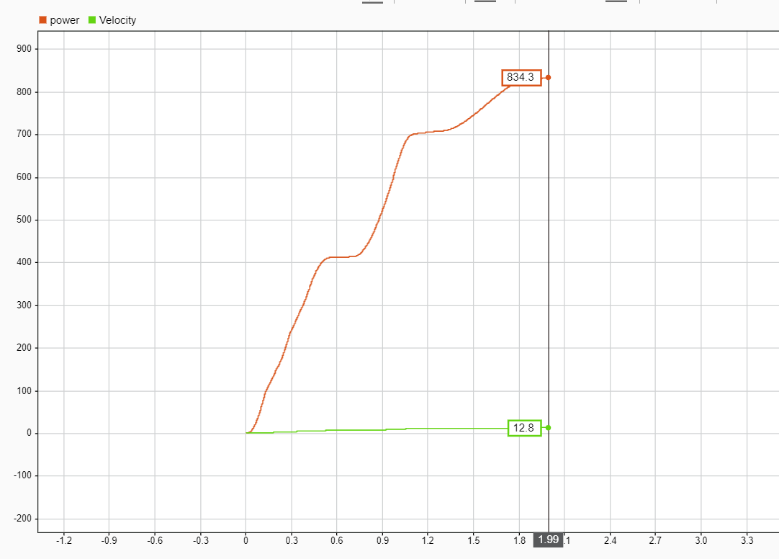
SIMULINK MODEL AND RESULT

Slide 12
RESULTS
Gradient max speed – 10.7 m/s
Linear max speed Full Loading Single motor – 12.8 m/s
Full Loading Dual Motor -13.48 m/s
Max Regenerative power – 834.3W

